Slide 1
Scale of Geologic Time: A Scientific Chart
Concept: Visual Media

Slide 2
Essential Question
How do visual media use literary elements to present information?
Visual media present data in the form of charts and graphs to allow readers to see and analyze large amounts of information. This form of media encourages readers to draw conclusions and make inferences when limited details are available.

Slide 3
Examples of Visual Media
Photographs
Illustrations
Charts
Graphs
Diagrams
Maps
Time Lines

Slide 4
Drawing Conclusions
When looking at a diagram or chart, readers must draw conclusions based on the limited details presented.
Look at the chart on page 408.
Do you know anything about the eras?
How is time divided?

Slide 5
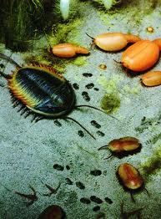
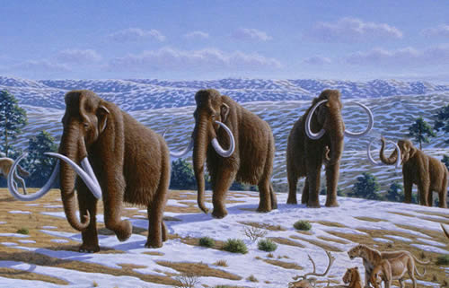
Helpful Hints
Paleozoic—
415 Million Years Ago
Mesozoic—
200 Million Years Ago
Cenozoic—
10 Million Years Ago

Slide 6
Drawing Conclusions
Create the chart below in your notes and draw a conclusion about the development of living organisms based on the information provided.
Evidence:
Organisms in lower portions of the scale seem to be less complex.
Evidence:
Conclusion:

